Slide 1

Problem Statement and Team Details
Problem Statement:
Team Name:
Team Leader Name:
Institute Name:
Team Leader Email ID:
CFO Helper - Bringing Clarity to Complexity
Code Crafters
Manda Akshaya (2420030438)
KL University, Bachupally.
2420030438@klh.edu.in

Slide 2
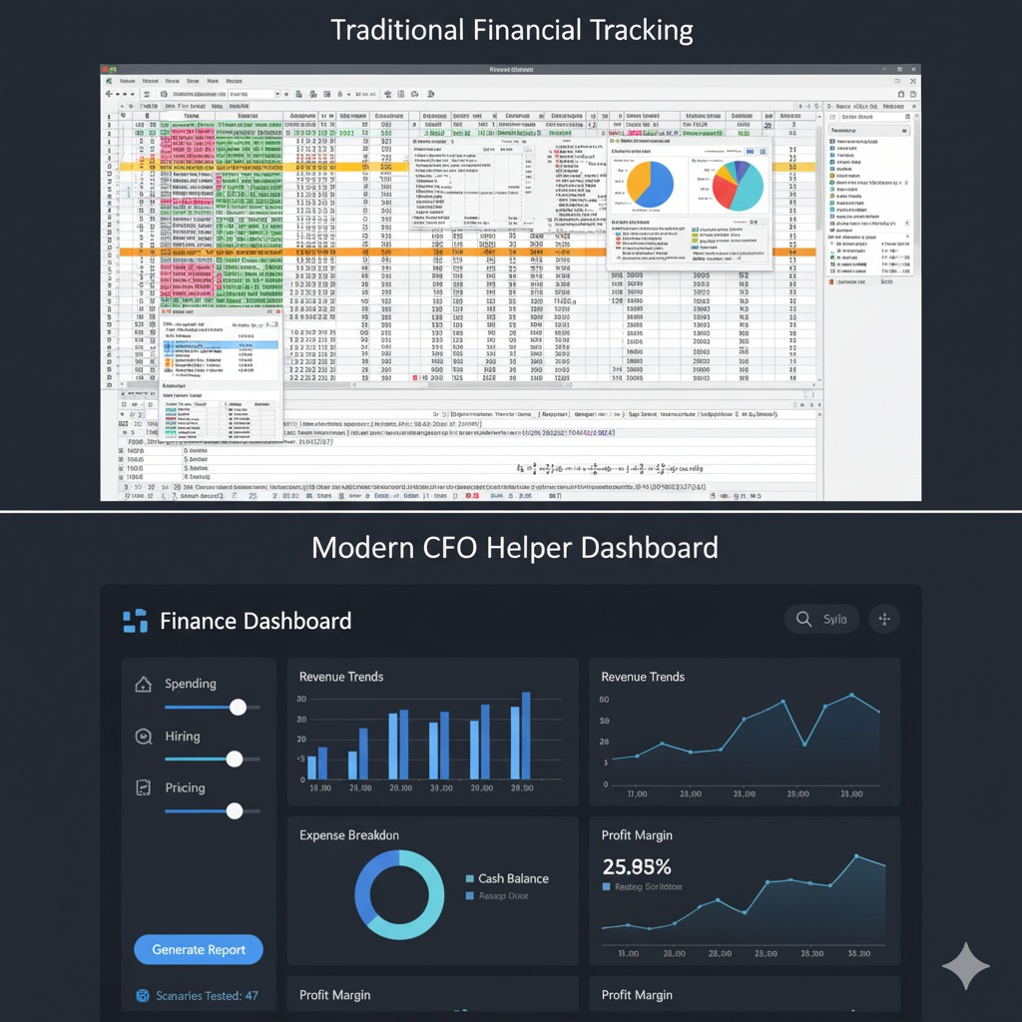
Problem and Solution
Problem:
People struggle with forecasting:
Can I survive 6 months if I hire more?
What if I raise prices 10%?
Managing finances is a major challenge for startups, student events, and small businesses. Traditional tools like Excel are either too basic or too complex, and they fail to answer “what-if” financial scenarios.
Solution:
CFO Helper Agent:
Interactive sliders (hiring, spending, pricing).
Instant financial impact shown in charts.
Shareable mini reports.
Flex-price: pay per simulation/report.
Pathway: live financial data.

Slide 3
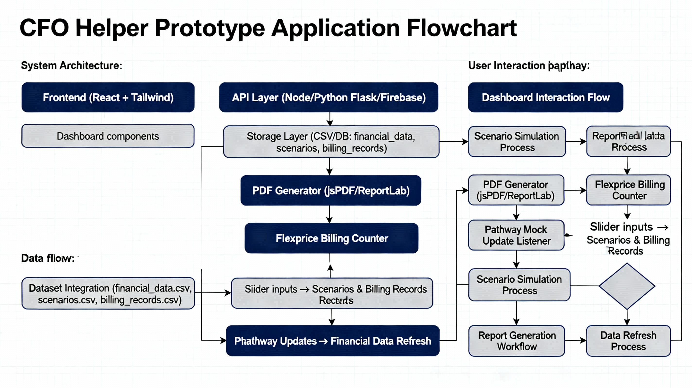
Methodology & Implementation

Slide 4
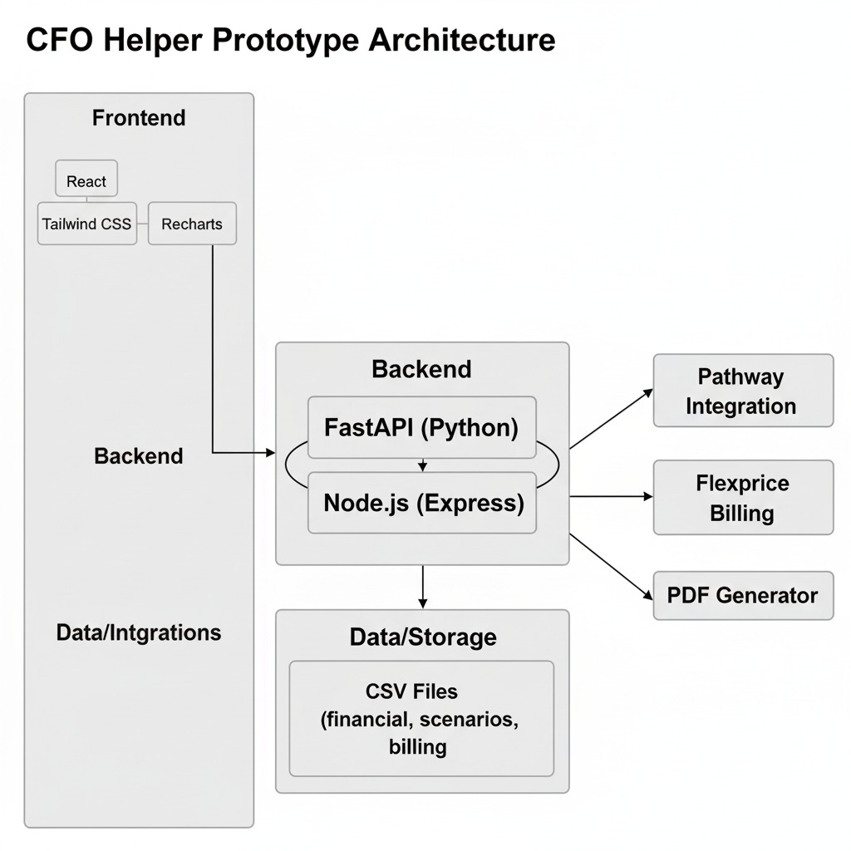
Technology Used
Frontend: We built the user interface using React and Tailwind CSS for a fast, responsive, and clean design. We used Recharts to generate the clear, dynamic charts.
Backend: The logic that handles all the calculations is powered by a mock API built with either FastAPI (Python) or Node.js.
Data & Integrations: The backend interacts with our mock CSV files which act as our database. It also handles the connection to the Pathway Integration (for data updates), a PDF Generator (for reports), and the Flexprice Billing system (to track usage).

Slide 5
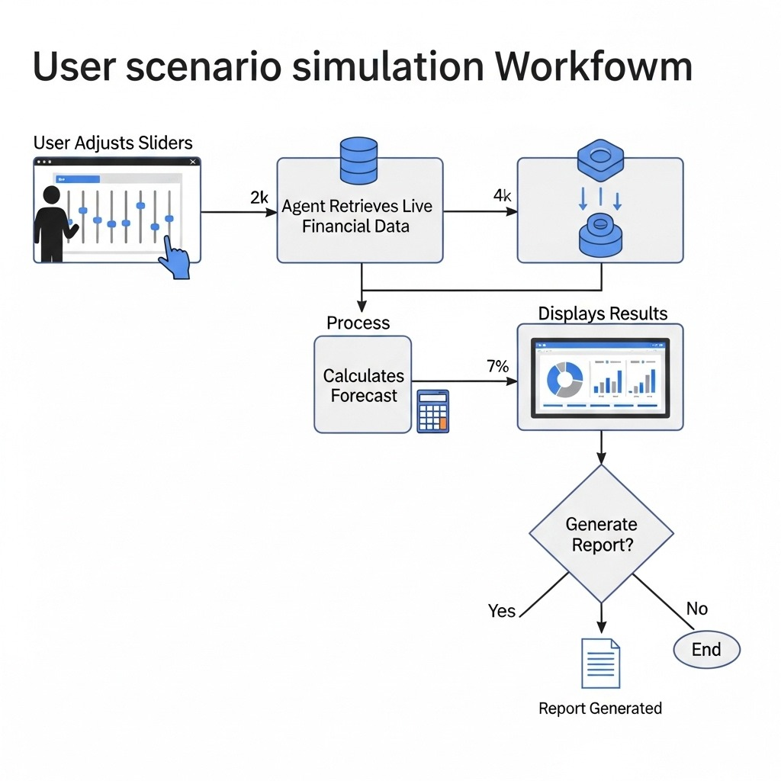

Flowchart & Supporting Images

Slide 6
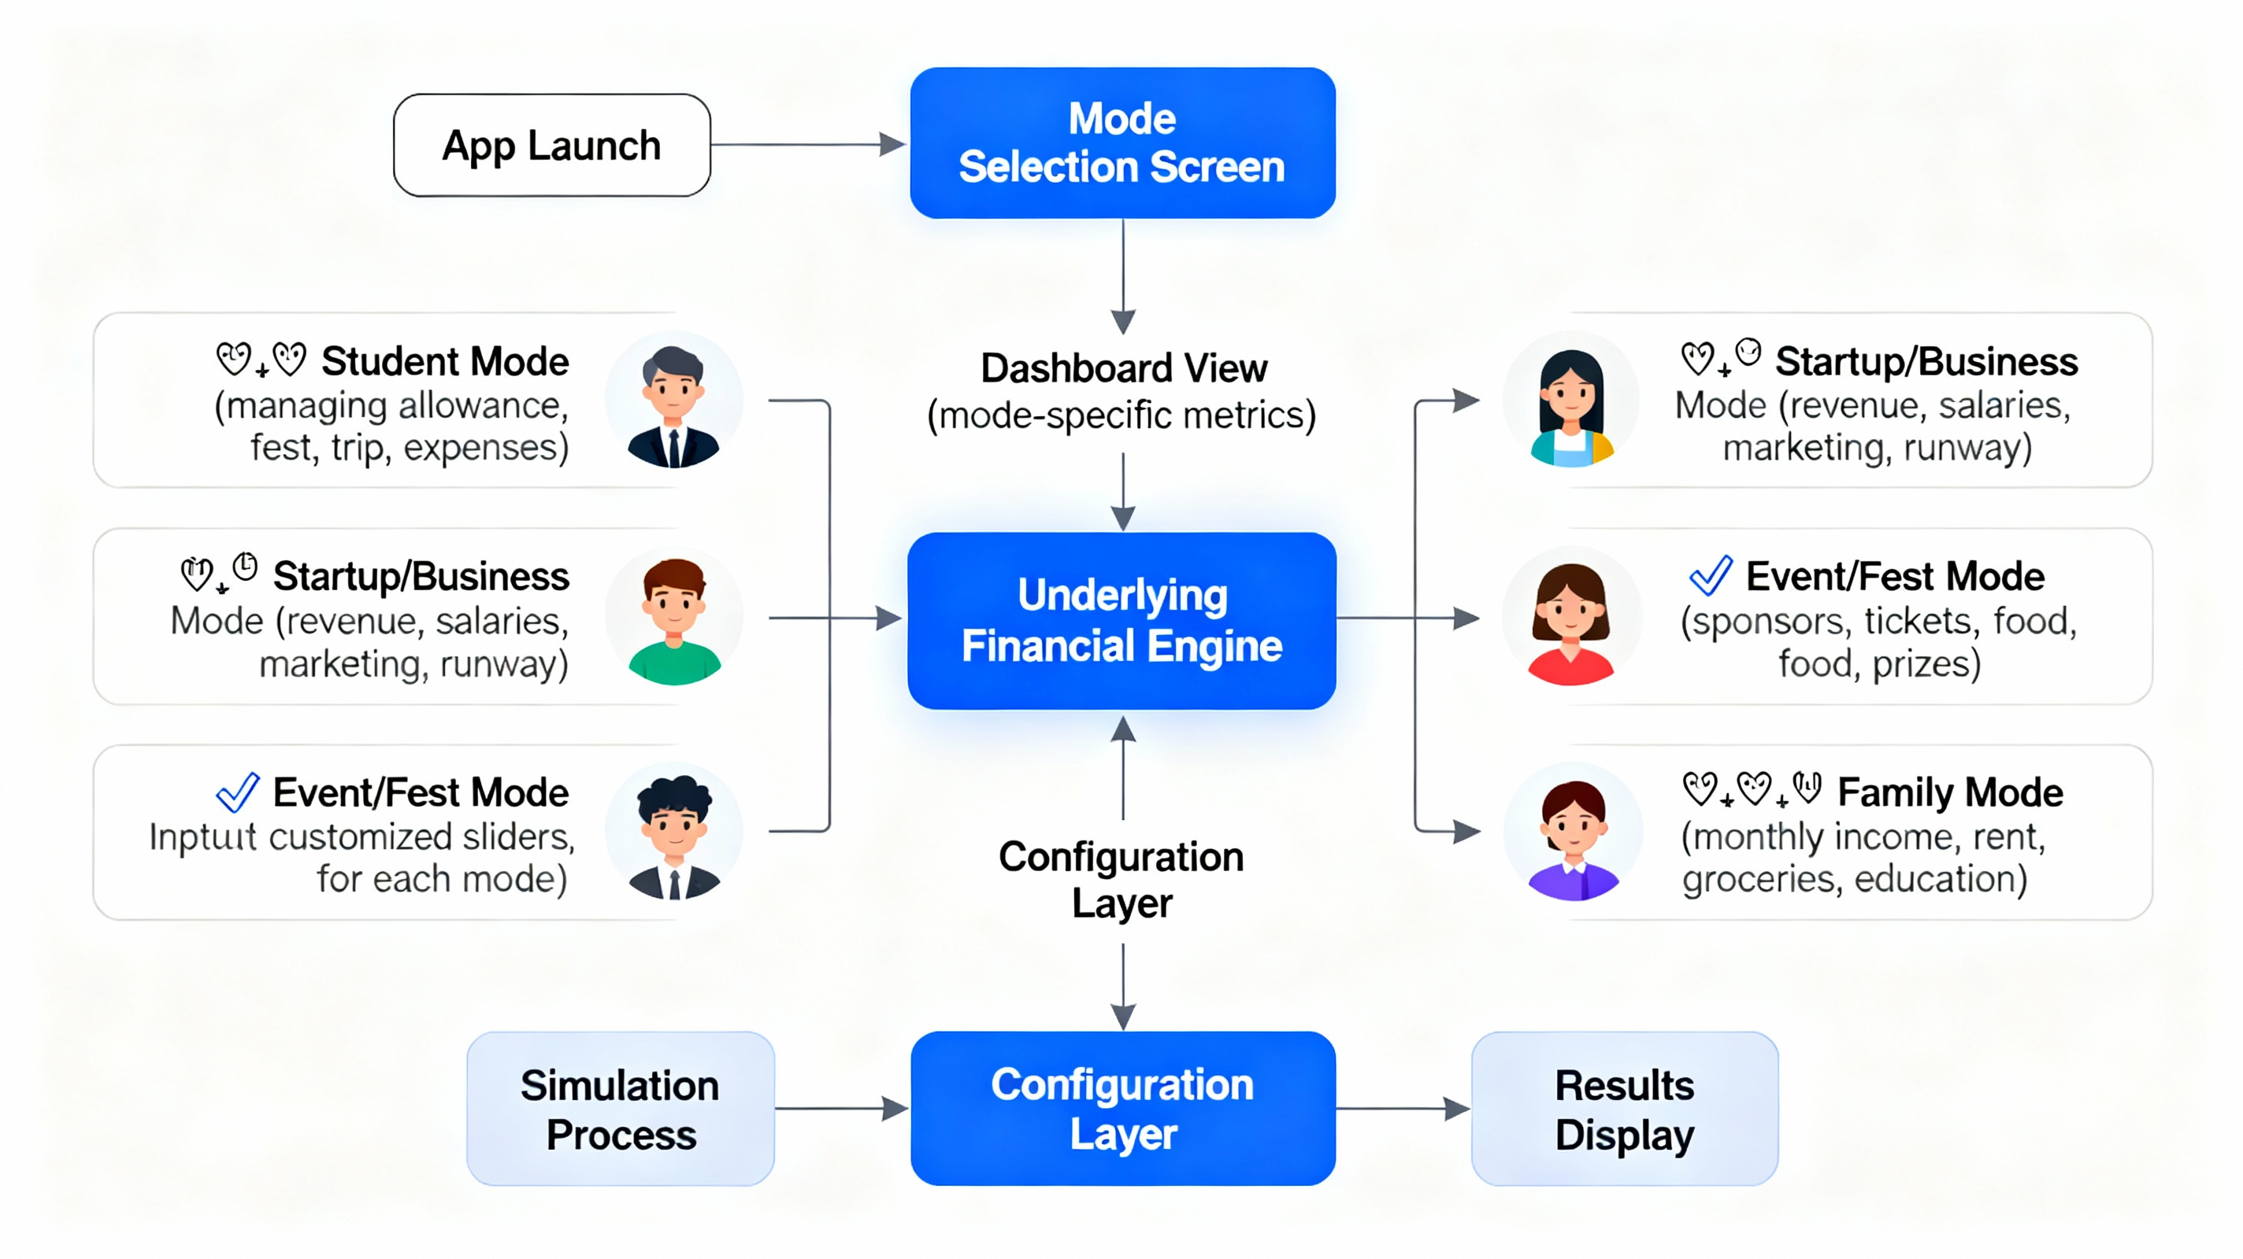
Feasibility and Market Use

Slide 7


Conclusion
CFO Helper transforms complex financial “what-if” questions into clear, actionable insights. By combining Pathway for live data and Flexprice for usage-based billing, it delivers accurate forecasts, easy-to-share reports, and fair pricing. It is a practical, scalable, and user-friendly finance co-pilot for startups, student events, and small businesses.
After Using CFO Helper

